Slide 1

Testing Statistical Hypothesis
Dr. Abolfazl Saghafi
Assistant Professor of Statistics & Data Science
Data Science Program Director
Chapter 7 Part 2
Notes:
We will proceed testing by more definitions and properly formulating a testing for mu
Sans Forgetica font is designed using the principles of cognitive psychology to help you to better remember your study notes.

Slide 2
Recall
Ex1. A pharmaceutical company that produces a certain drug claims that it is 80% effective in reducing blood pressure.
Ex2. Channel 5 news states that children in the United States watch an average of 3 hours of TV per week.
Ex3. A car company claim that their new electric car can run on average at least 200 miles after fully charged.
Ex4. The mad king where suiters had to decide whether a coin is fair or biased toward showing more heads.
Notes:
First a recall of our past four examples

Slide 3








Testing Statistical Hypotheses
Testing Statistical Hypothesis. The process of using sample data to Accept/Reject H₀ is called testing statistical hypothesis.
Test statistic. In testing process, a point estimate of the parameter under claim is used to decide which of the null or alternate hypothesis are correct.
$$H_{0}:p=0.80$$
$$H_{0}:μ=3$$
$H_{0}:μ≥$ 200
$$H_{0}:p=0.5$$
$$H_{1}:p≠0.80$$
$$H_{1}:μ≠3$$
$H_{1}:μ<$ 200
$$H_{1}:p>0.5$$
Notes:
Write down the point estimations for parameters under claim in examples 1-4 in the given boxes.

Slide 4
















Acceptance Region
$$0$$
$$p$$
$$0.8$$
$$1$$
$$0$$
$$200$$
$$μ$$
$$∞$$
$$0$$
$$3$$
$$μ$$
$$24$$
AR
$$(c≤\hat{P}≤d)$$
$$(c≤\overline{X}≤d)$$
$$(\overline{X}≥c)$$
$$(X≤c)$$
$$H_{0}:p=0.80$$
$$H_{0}:μ=3$$
$H_{0}:μ≥$ 200
$$H_{0}:p=0.5$$
$$H_{1}:p≠0.80$$
$$H_{1}:μ≠3$$
$H_{1}:μ<$ 200
$$H_{1}:p>0.5$$

Slide 5

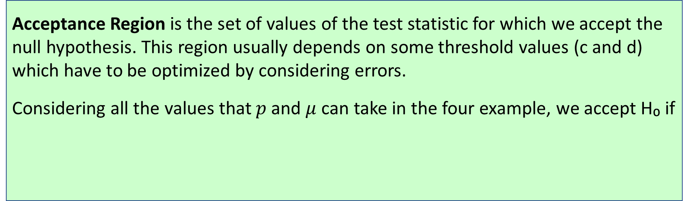



Acceptance Region
Acceptance Region is the set of values of the test statistic for which we accept the null hypothesis. This region usually depends on some threshold values (c and d) which have to be optimized by considering errors.
Considering all the values that $p$ and $μ$ can take in the four example, we accept H₀ if
$$(c≤\hat{P}≤d)$$
$$(c≤\overline{X}≤d)$$
$$(\overline{X}≥c)$$
$$(X≤c)$$
$$H_{0}:p=0.80$$
$$H_{0}:μ=3$$
$H_{0}:μ≥$ 200
$$H_{0}:p=0.5$$
$$H_{1}:p≠0.80$$
$$H_{1}:μ≠3$$
$H_{1}:μ<$ 200
$$H_{1}:p>0.5$$
Notes:
In example 1, p is a population proportion with values in [0, 1]. If the values of point estimation are within a safe distance from 0.80, then we have evidence to accept H₀. This safe distance is called the acceptance region. To determine the exact boundaries for this safe distance we need to minimize the two types of error.
In example 3, mu is population mean with values in [0, ∞]. If the values of Xbar are within a safe distance from 200 and above, then we we have evidence to accept H₀. This safe distance is called the acceptance region.

Slide 6





Rejection Region (RR)
Rejection Region is the set of values of the test statistic for which the null hypothesis is rejected. This region compliments the acceptance region.
Critical Value or Threshold: The aim is to find best values of c and d that minimizes both α and β, but these two errors cannot be minimized simultaneously. So we fix the value of α to some pre-specified significance level and find the thresholds c and d that minimizes β.
$$\left(\hat{P}<c\right)∪(\hat{P}>d)$$
$$(\overline{X}<c)∪(\overline{X}>d)$$
$$(\overline{X}<c)$$
$$(X>c)$$
$$H_{0}:p=0.80$$
$$H_{0}:μ=3$$
$H_{0}:μ≥$ 200
$$H_{0}:p=0.5$$
$$H_{1}:p≠0.80$$
$$H_{1}:μ≠3$$
$H_{1}:μ<$ 200
$$H_{1}:p>0.5$$
Notes:
We do not discuss how to find the optimum c and d since it is too complicated for the sake of this course, we just use the optimized thresholds.

Slide 7
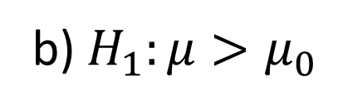
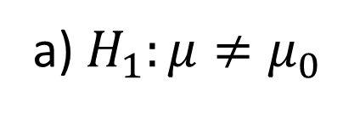
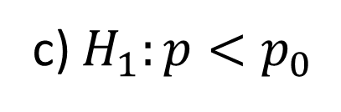
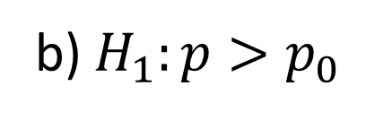

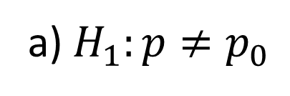

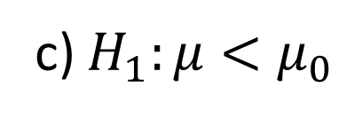
Testing
In this chapter we cover testing these hypotheses
Simple Null
a) $H_{1}:μ≠μ_{0}$
Any problem you deal with from now on, the null should be expressed with
=
Two-sided Alternate
$$H_{0}:μ=μ_{0}$$
b) $H_{1}:μ>μ_{0}$
One-sided Alternate
c) $H_{1}:μ<μ_{0}$
a) $H_{1}:p≠p_{0}$
Two-sided Alternate
are given numbers
$$H_{0}:p=p_{0}$$
b) $H_{1}:p>p_{0}$
One-sided Alternate
c) $H_{1}:p<p_{0}$

Slide 8
P-value
The testing is sometimes performed using p-value which is defined as “the probability that the observed value or something more extreme is seen under the assumption that null hypothesis is true”.
If ( p-value < α ) Then Reject H₀ at α% significance level
Notes:
This is a VERY IMPORTANT definition

Slide 9
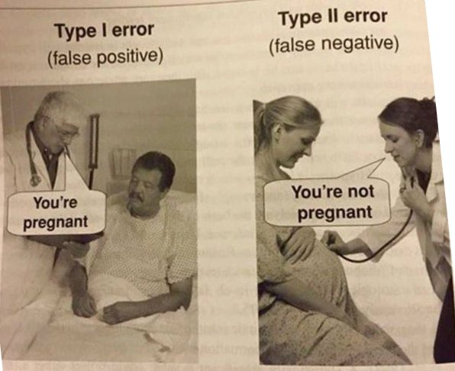
Testing Statistical Hypothesis
Case I and II
Notes:
No comment!

Slide 10
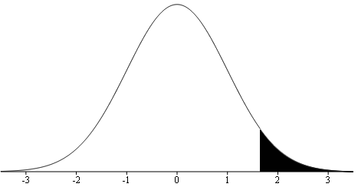




Testing population Mean (μ)
Known
I
II
1. Find out the significance level α, use α = 0.05 if not given
n ≥ 30
2. Write down the null (H₀: μ = μ₀) and alternate (either
H₁: μ ≠ μ₀, H₁: μ > μ₀, or H₁: μ < μ₀) hypothesis
Normal Distribution
3. The test statistics is $Z=\frac{\overline{X}−μ_{0}}{σ/\sqrt{n}}$ compute its value
4. Determine the rejection region considering the alternate
Critical Value:
= Invnorm(1-α/2)
$$z_{1−α/2}$$
$$\left|Z\right|≥z_{1−α/2}$$
$$Z≥z_{1−α}$$
$$Z≤{−z}_{1−α}$$
5. Reject H₀ if the computed value of $Z$ is in the rejection region, fail to reject otherwise
6. Making an inference statement relating the decision to the problem
Notes:
Earlier we discussed making inference about pop mean and introduced three population types. The six-step procedure here explain how we perform a testing hypothesis in type I and II populations. The process is as follows, pay attention to the form of the rejection region which depends on the form your alternate hypothesis.
Step 1: Specify (given) the significance level, α, commonly used values are α = 0.10, 0.05, 0.01
Step 2: State the null hypothesis and the alternate hypothesis so as to reflect the question’s claim.
Step 3: Write down the test statistic, compute its value given the provided information.
Step 4: Determine the RR based on the type of the alternate.
Step 5: Make a decision to accept or reject the null hypothesis based on the value from step 3 and RR.
Step 6: State the decision with regard to the problem.
$\left|Z\right|≥z_{1−α/2}$ means $\left(Z≤−z_{1−α/2}\right)Or\left(Z≥z_{1−α/2}\right)$

Slide 11
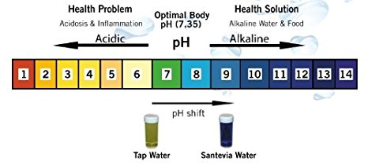



Ex1. Chemical Analysis of Water
The state of Pennsylvania claims that the mean pH levels of water in Philadelphia is 8.1, from historical data we know that the distribution of pH level is normal with standard deviation of 0.3
A random sample of 42 readings shows a sample average of 8.25. At 0.05 level of significance test the claim that there is a mean pH of 8.1 compared to the alternative that the pH is different either way.
X: pH level ~ Normal (μ, σ = 0.3)
I
$$\overline{x}=8.25$$
$$μ_{0}=8.1$$
$$n=42$$
Claim: the mean pH is 8.1
Alternative: The pH is different either way
Notes:
We have a population type I since normal distribution and population standard deviation are given. We then simply follow the six steps to perform the testing and make a final statement

Slide 12
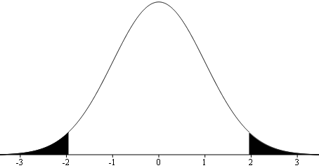

1. α = 0.05
2. versus
3. Test Statistic:
4. Rejection Region:
$$\left|Z\right|≥z_{0.975}=1.96$$
5. z = 3.24 is in the rejection region, so H₀ is rejected
6. At 5% level of significance there is sufficient evidence that the mean pH is NOT equal to 8.1
7.
Notes:
Since the p-value is less than the significance level 0.05, H₀ is rejected at 5% significance level. This is the same decision we made using the six-step process.
$$z_{0.975}=invNorm\left(0.975,0,1\right)=1.95$$

Slide 13

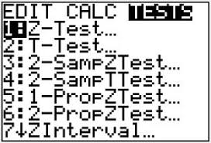
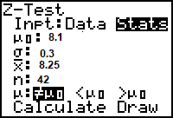
Using Calculator
Don’t be a Morty in using your calculator be at least a summer!
You can use the calculator to do pretty much the whole testing.
You should know your population type, the form of the alternate and some statistic to perform the testing.
Press STAT and the right arrow twice to select TESTS.
Select the highlighted 1:Z-Test… Press ENTER.
Then either select Data (if you have entered your data into calculator) or Stats (if you have the statistics) and proceed.
Notes:
Practice using the calculator to check your final answer AND to score higher on the multiple-choice post-assessment test

Slide 14
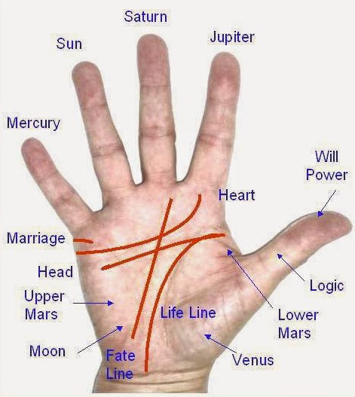
Ex2. Palm Reading
Some people believe that the length of their palm’s lifeline can be used to predict longevity.
In a letter published in the Journal of the American Medical Association, authors M. E. Wilson and L. E. Mather refuted that belief with a study of cadavers.
Ages at death were recorded, along with the length of palm lifelines. The authors concluded that there is no significant evidence supporting that claim.

Slide 15



Ex3. CO2 Measurement
The mean CO2 measurement in a small town used to be around 340ppmv with standard deviation of 20.
After a new company has been built in close proximity of this town, a random sample of 36 measurements show and average CO2 of 345ppmv.
At 5% level of significance test the company’s claim that the amount of CO2 is still the same against its one sided alternate hypothesis that it has increased.
X: CO2 measurement ~ ? (μ, σ = 20)
n = 36
$$\overline{x}=345$$
II
$$μ_{0}=340$$
Notes:
We have a population type II since distribution is unknown, the population standard deviation is given, and sample size is greater than 25. Therefore, we follow the procedure explained earlier.

Slide 16
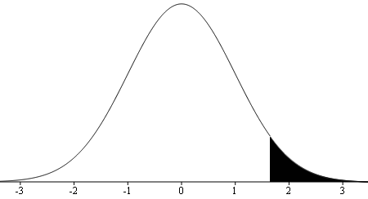


1. α = 0.05
2. versus
3. Test Statistic:
4. Rejection Region:
$$Z≥z_{0.95}=1.645$$
5. z = 1.5 is NOT within the rejection region, so H0 is NOT rejected
6. At 5% level of significance there is insufficient evidence to conclude that the mean CO2 is increased
7.
$$=normalcdf\left(1.5,∞,0,1\right)$$
Notes:
Follow the six steps and pay special attention to the form of the alternate hypothesis and the rejection region.

Slide 17

Practice Problems Part 2
1. The growth in three years of a certain variety of pine tree follows a closely bell-shaped distribution with average 10.1 inches and a standard deviation of 2.1 inches.
A biologist claims that a new variety will have a greater three year growth. A random sample of 25 of the new variety has an average three-year growth of 10.8 inches. Do we have significant evidence in the data to conclude that the new variety will have a greater three year growth? Test at 1% significance level.
This is especially important for businesses that grow Christmas pine trees.
Notes:
Answers are in Ch7 Practice Problem Solutions

Slide 18

Practice Problems Part 2
2. In the 1920s, the true expected lifespan of male dogs was 8.1 years with a standard deviation of 2 years. You gather data from a local vet and find that the average age of 15 randomly selected male dogs was 7.6 years and you notice that the corresponding histogram looked fairly normal.
At 10% significance level, do we have enough evidence to suggest that the average life span of male dogs has changed from the 1920s?
If the lifespan has changed, what could be contributing to this change? This is an interesting follow up question.
Notes:
Answers are in Ch7 Practice Problem Solutions

Slide 19
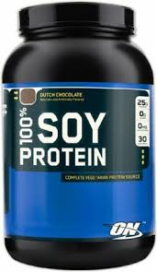
Practice Problems Part 2
3. A group of nutritionists is hoping to prove that a new soya bean compound has less protein per gram than roast beef, which has a mean protein content of 20. A random sample of 5 batches of the soya compound have been tested, with the following protein contents:
15, 20, 11, 17, 13
Assuming that the protein content of the soya bean compounds is normally distributed with variance 16, can we conclude that a new soya bean compound has less protein per gram than roast beef? Decide using 1% significance level.
Using protein supplements or fresh products has always been a question of athletes.
Notes:
Answers are in Ch7 Practice Problem Solutions

Slide 20

Practice Problems Part 2
4. A certain prescription medicine is supposed to contain an average of 250 (ppm) of a certain chemical. If the concentration is higher than this, the drug may cause harmful side effects; if it is lower, the drug may be ineffective.
The manufacturer runs a test to see if the mean concentration in a large shipment conforms to the target level of 250 ppm. A simple random sample of 100 portions is tested, and the average concentration is found to be 247 ppm.
If historical data suggests a standard deviation of 12 ppm for the population, test the drug effectiveness.
This is VERY important as it deals directly with health of individuals.
Notes:
Answer is not provided, you should be able to confidently figure it out after going over the past problems.

